Slide 1
Cloud deployment models
35698 - Bharath Mummadi

Slide 2
What are cloud deployment models?
cloud deployment model describes the specific ownership, management, and workload parameters of the cloud environment.
Public Cloud
Private Cloud
Hybrid Cloud
Community Cloud

Slide 3
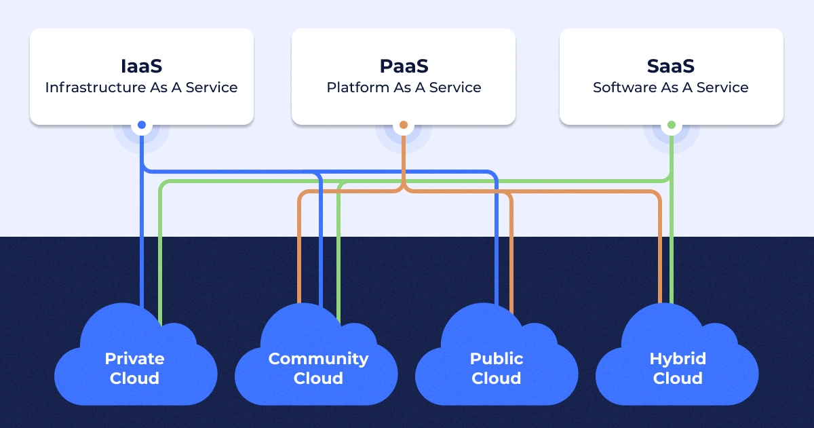
Deployment Models Overview

Slide 4
Public Cloud
Users pay for what they use, which can be more cost-effective than maintaining on-premises infrastructure.
Public clouds are owned and operated by third-party providers who deliver services over the internet.
Providers handle maintenance, updates, and security patches, reducing the burden on users' IT departments.

Slide 5
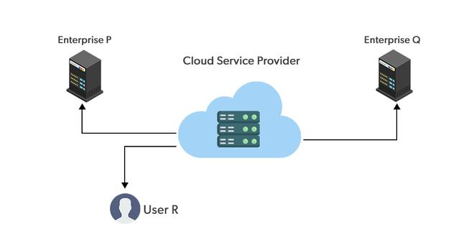
How Public works?
The fundamental characteristics of public clouds are multitenancy. A public cloud is meant to serve multiple users, not a single customer.

Slide 6
Private cloud
The infrastructure is dedicated to a single organization, providing greater control over the environment.
Organizations can implement security measures that meet their specific needs and comply with regulatory requirements.
Private clouds can be more expensive due to the need for dedicated resources and the costs associated with setup, maintenance, and management.

Slide 7
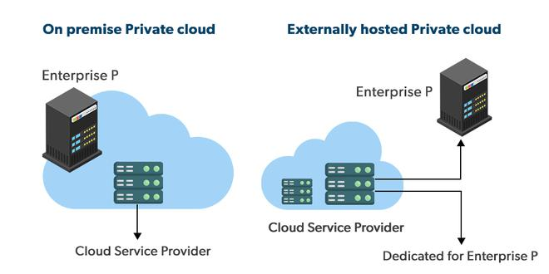
How Private works?
Private clouds are distributed systems that work on private infrastructure and provide the users with dynamic provisioning of computing resources.

Slide 8
Hybrid cloud
Hybrid clouds offer the flexibility to use public cloud services for less sensitive applications while keeping sensitive data and applications in a private cloud.
Hybrid clouds can offer better performance for certain applications by allowing data to be processed in the mo
Organizations can implement different security measures for different types of data, enhancing overall security.st efficient location.

Slide 9
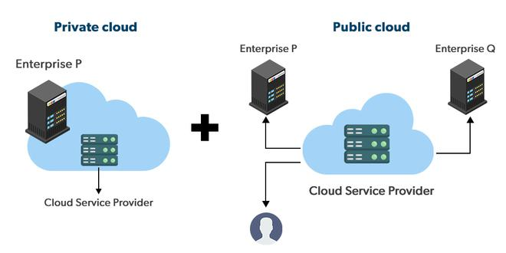
How Hybrid works?
A hybrid cloud is a heterogeneous distributed system formed by combining facilities of the public cloud and private cloud.

Slide 10
Community cloud
Organizations from a specific community share the same cloud infrastructure, which can be managed internally or by a third party and hosted either internally or externally.
Community clouds can provide enhanced security and privacy compared to public clouds.
The community cloud is designed for organizations that have shared interests, such as a common application, security requirements, policy, and efficiency demands.

Slide 11
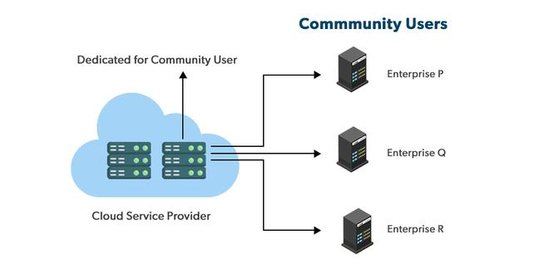
How Community works?
Community clouds are distributed systems created by integrating the services of different clouds to address the specific needs of an industry, a community, or a business sector.

Slide 12
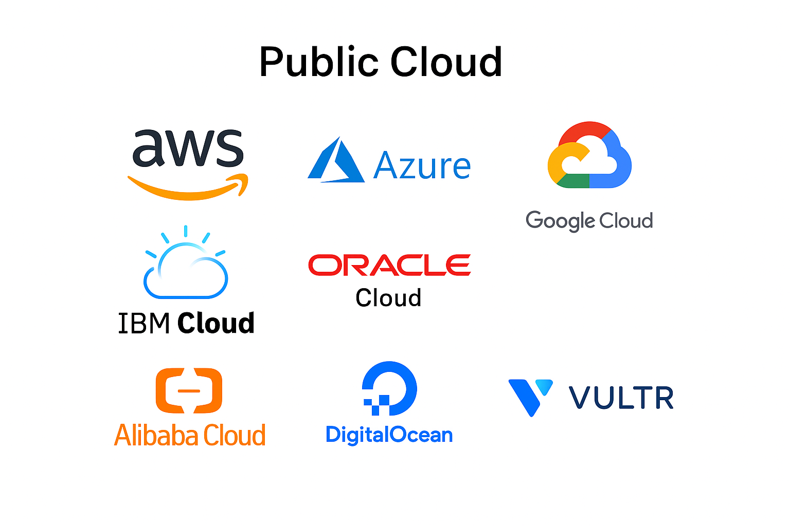
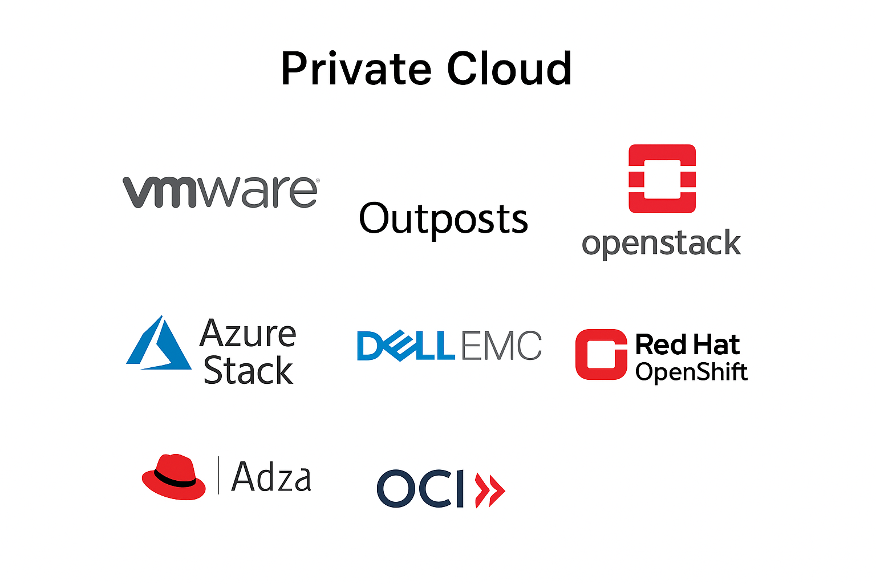
Cloud examples

Slide 13
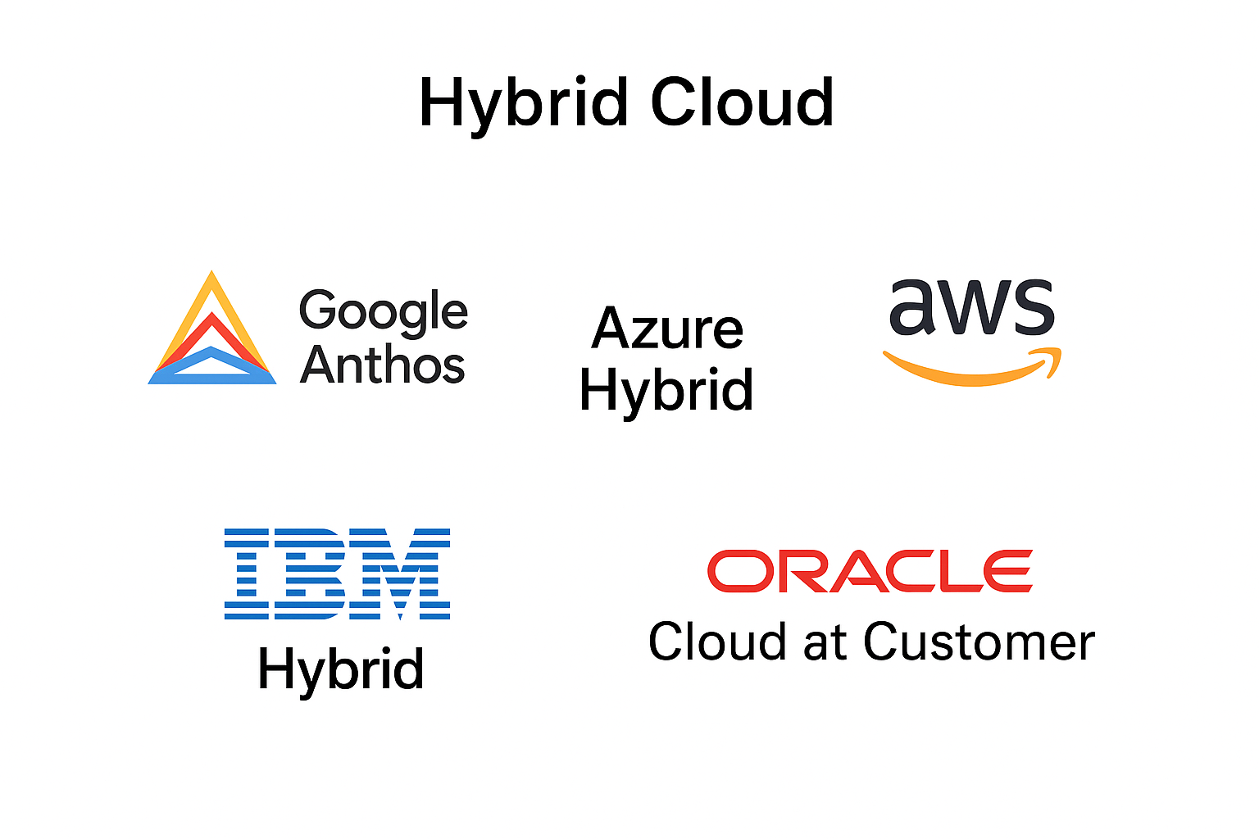
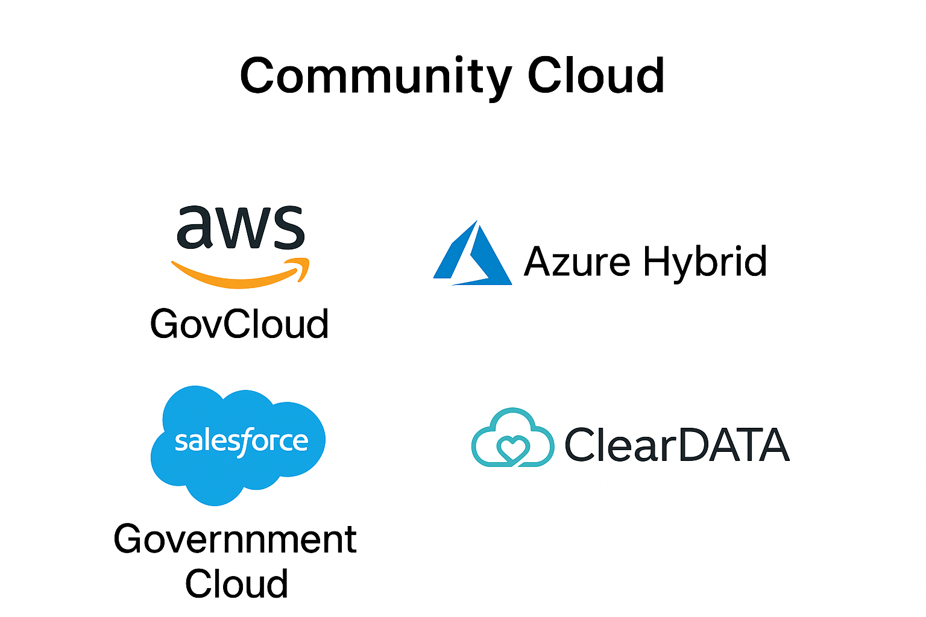
Cloud examples

Slide 14
Thank You

